Slide 1
Apollo Renal Therapeutics Water Filtration Project
Team 504
Kencin Autry, Matthew Kennedy, Timothy Norman,
Lapadre Proctor, Lily Thompson

Slide 2
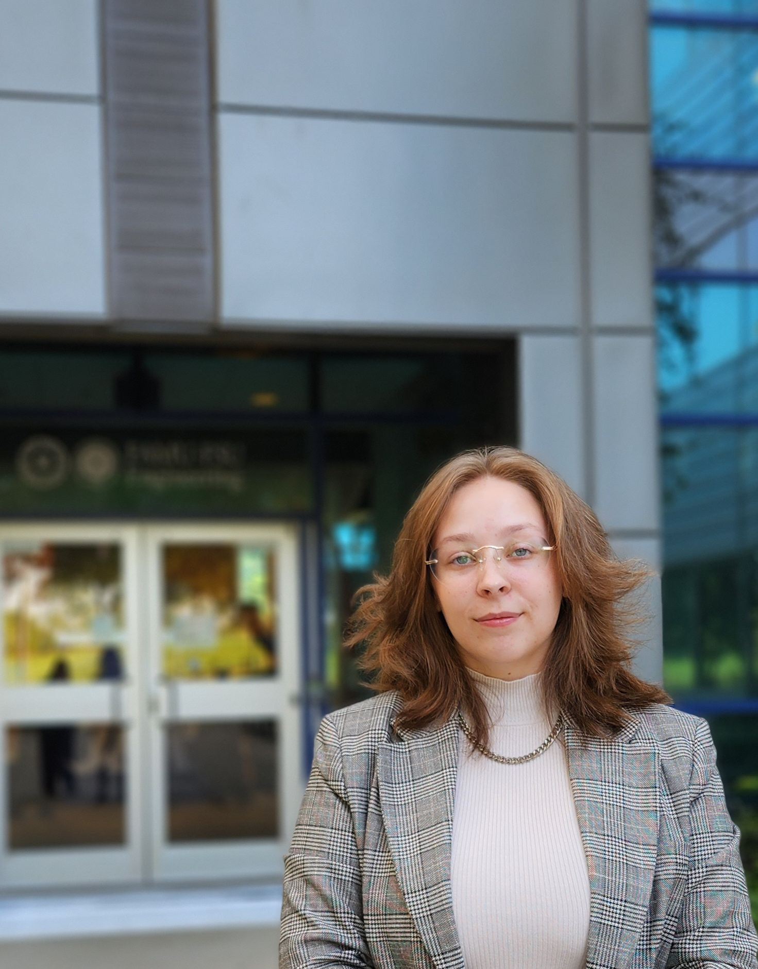
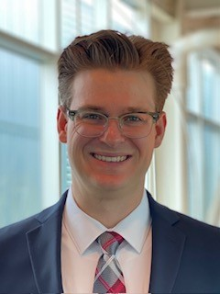
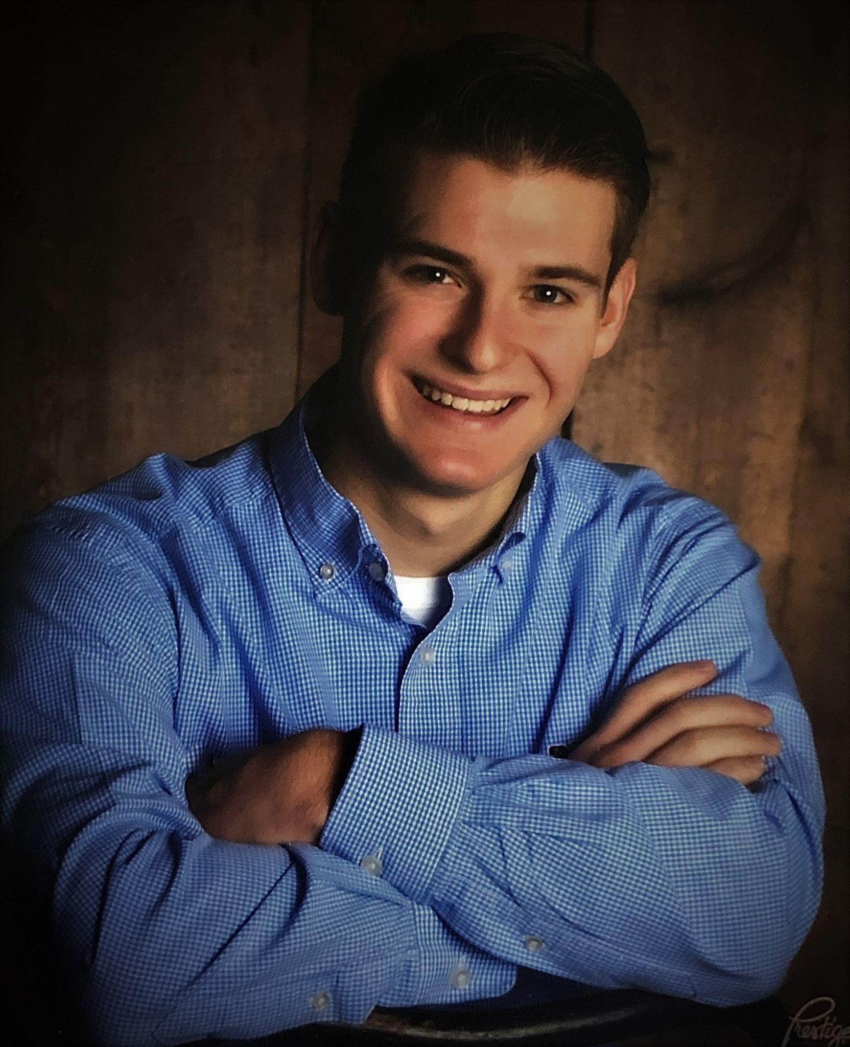

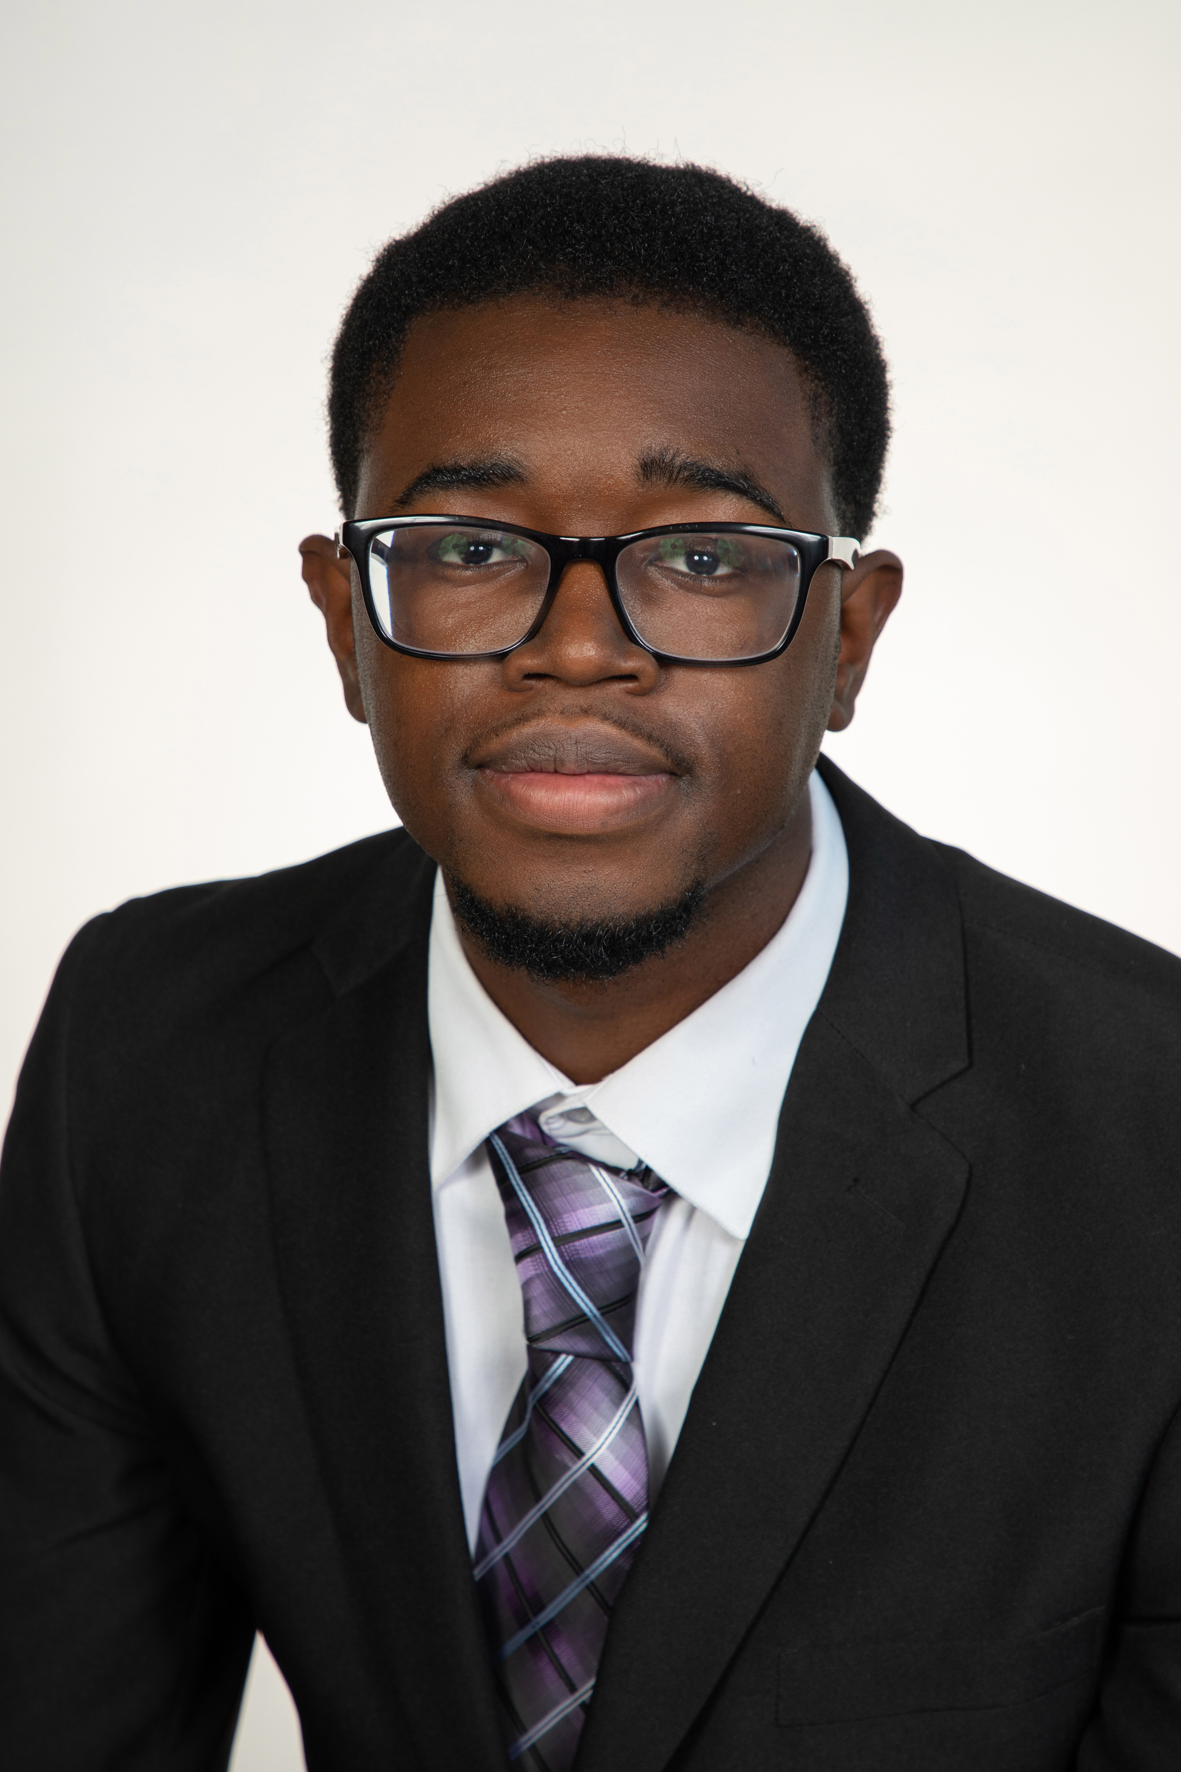
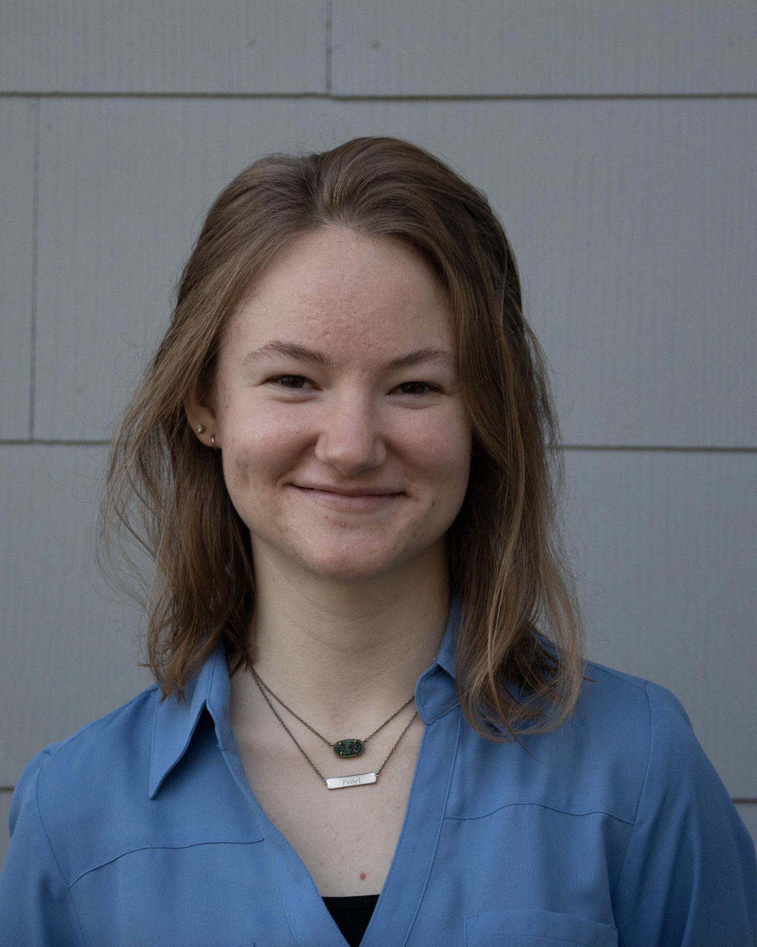
Lapadre Proctor
Team Introductions
Kencin Autry
Research
Development
Engineer
Matthew Kennedy
Structural Design
And Materials
Engineer
Timothy Norman
Structural Design
And Manufacturing
Engineer
Lapadre Proctor
Test and Quality
Control Engineer
Lily Thompson
Computational
Fluids Engineer
2

Slide 3
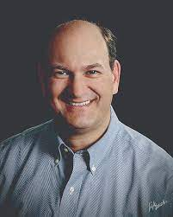
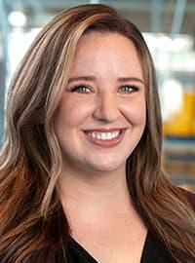
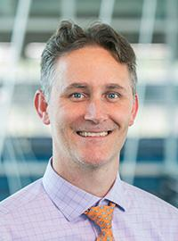



Lapadre Proctor
Sponsor and Advisor
Sponsor
Gary Mishkin
CEO Apollo Renal Therapeutics
DBA Artemis Plastics
Academic Advisor
Dr. Rebekah Sweat
Assistant Professor
Academic Advisor
Dr. Shayne McConomy
Senior Design Professor

Slide 4
Lapadre Proctor
Objective
The objective of this project is to reduce the quantity of waste-water in the dialysis process by efficiently purifying standardized filtered water and spent dialysate to ultra-pure water.
Notes:
l

Slide 5
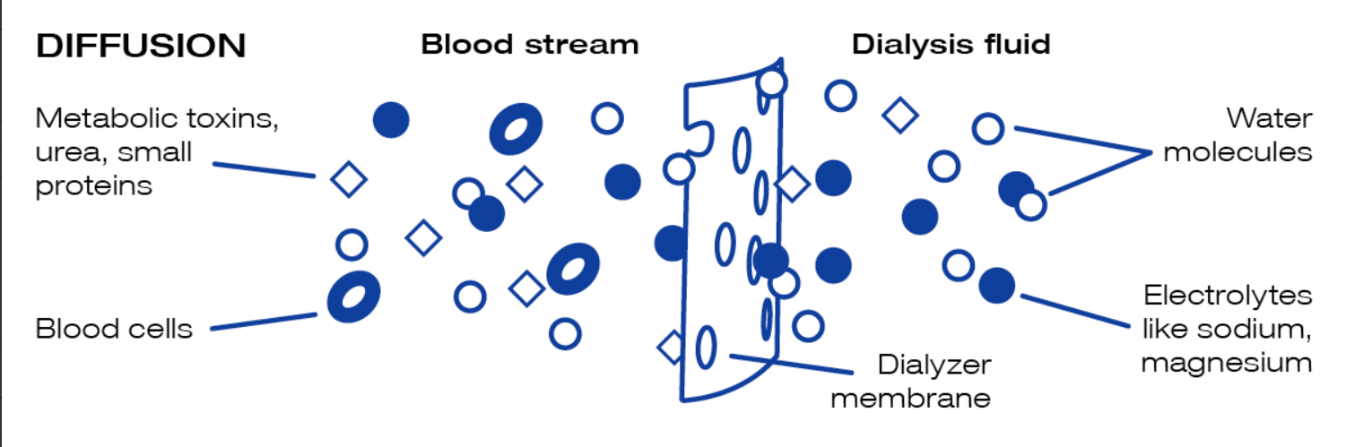
What is Dialysate?
Lapadre Proctor

Slide 6
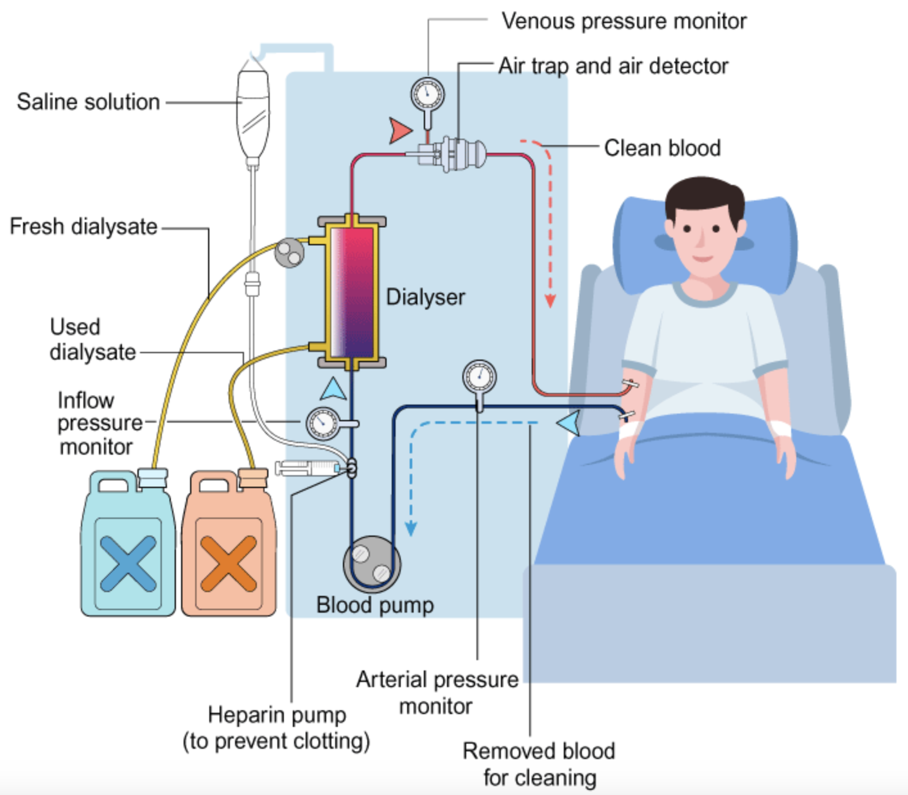
Lapadre Proctor
Project Background
Hemodialysis is a therapy treatment for patients with end-stage kidney disease (ESKD).
6

Slide 7
Lapadre Proctor
Hemodialysis Process
7

Slide 8



Lapadre Proctor
Key Goals
Enhancing efficiency and preventing the potential hazards of large water filtration systems
Recycling spent dialysate back into ultra-pure water
Filtered water will meet ultra-pure water standards
8

Slide 9
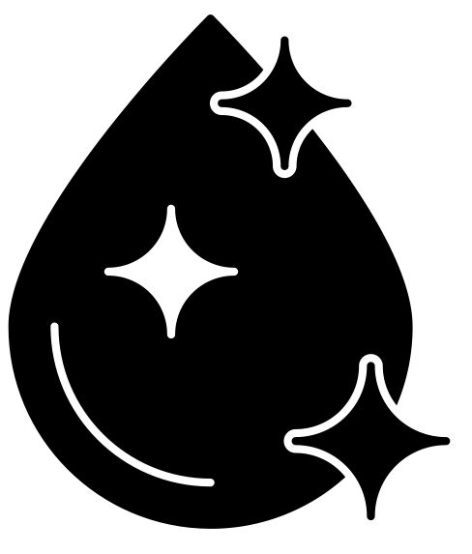
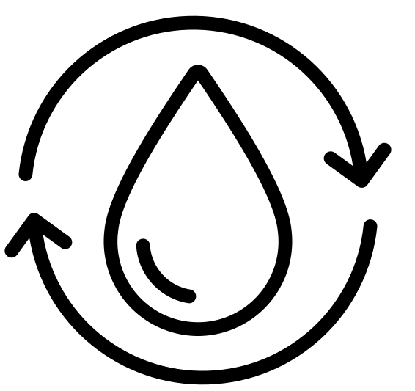


Critical Targets and Metrics
Lapadre Proctor
Purify Water
Recycle Spent Dialysate
Ergonomic Compatibility
Raise and Lower Flow Rate
< 0.001 ppm TDS
75% Efficiency
10 x 12 x 5 in
100 – 1000 mL per minute

Slide 10

Concept Generation
Lapadre Proctor
Secondary Dialyzer
Lego Sorter
Nanofiltration and Reverse Osmosis
Chemical Coagulant
Nanofiltration
Notes:
Do we wanna include all of this???

Slide 11
High-Fidelity
Lapadre Proctor
Carbon Nanotube (CNT) and Ultrasonics
Forward Osmosis
Gaseous Ozone

Slide 12
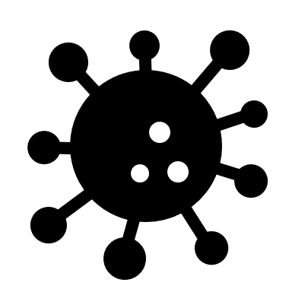
Carbon Nanotube (CNT) and Ultrasonics
Lapadre Proctor

Slide 13
Final Concept
Lapadre Proctor
Carbon Nanotubes (CNTs) and Ultrasonics
Reverse Osmosis (RO)

Slide 14
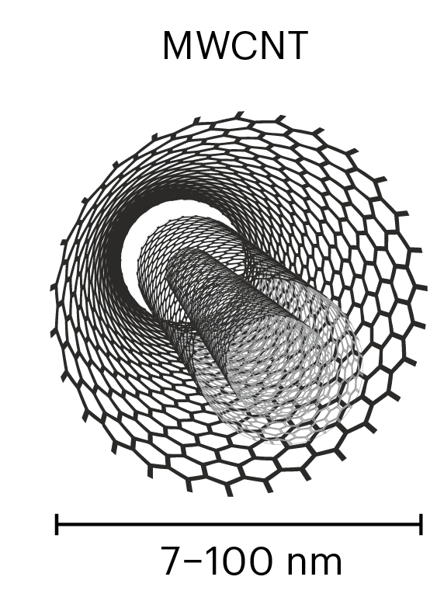
Carbon Nanotubes (CNTs)
Timothy Norman
Tubes made of carbon that have incredible tensile strength and conductivity
Multi-Walled Carbon Nanotubes (MWCNTs) are layered nanotubes that provide unique diameter variability
Can be used in the form of yarns, fabrics, bucky paper and resin infused bucky paper

Slide 15
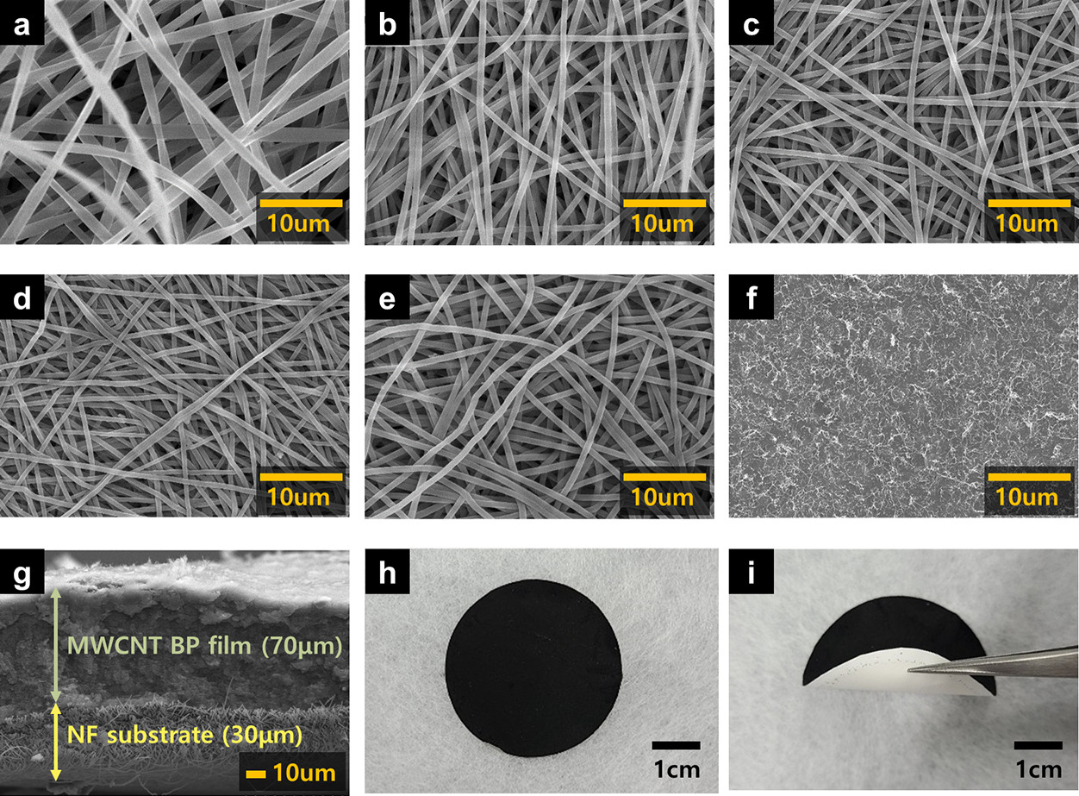
Bucky Paper CNT Film
Timothy Norman
Multi-Walled Carbon Nanotube (MWCNT) Film
Bucky paper thickness of about 0.06mm
Randomized dispersion with individual strands entangling

Slide 16
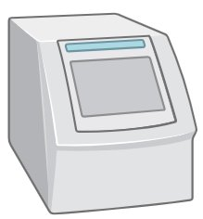
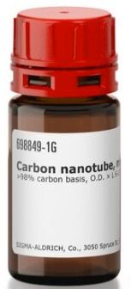
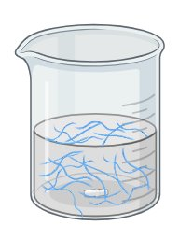
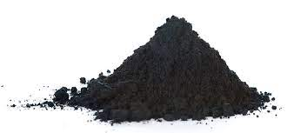
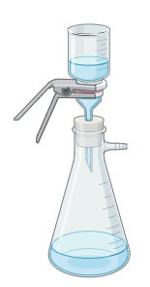
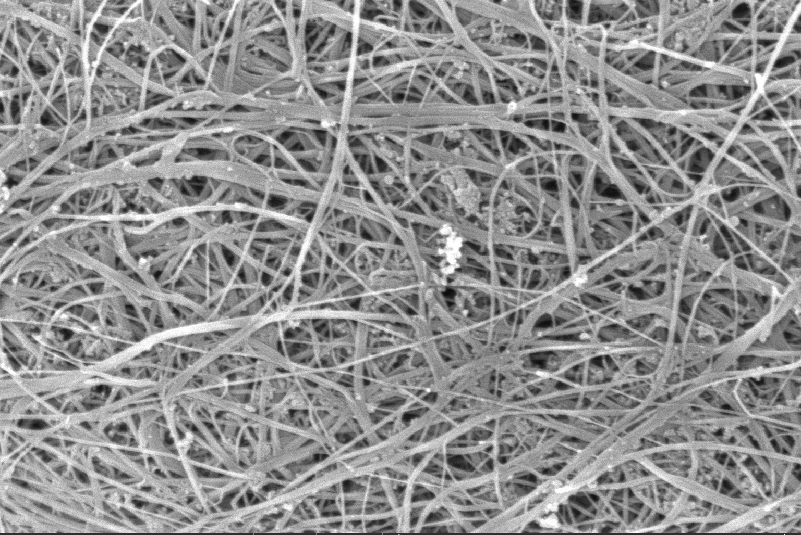
“Bucky paper” Production
Timothy Norman
Sonicator
Powdered CNTs
Final Bucky Paper
Vacuum Aided Filtration

Slide 17
Sonication Process
Timothy Norman
3.2
0.4
0.0.18
0.9

Slide 18
Sonication Process
Timothy Norman
0.4
0.0.18
3.2
0.9

Slide 19
Sonication Process
Timothy Norman
0.4
0.0.
3.2
0.9

Slide 20
Sonicator Components
Timothy Norman
Probes
Transducers
Generator

Slide 21
Sonicator Components
Timothy Norman
Generator
Converts electrical power to electrical signal
Transducer
Converts electrical signal into vibrations
Probe
Takes vibrations and amplifies them to create disturbances

Slide 22
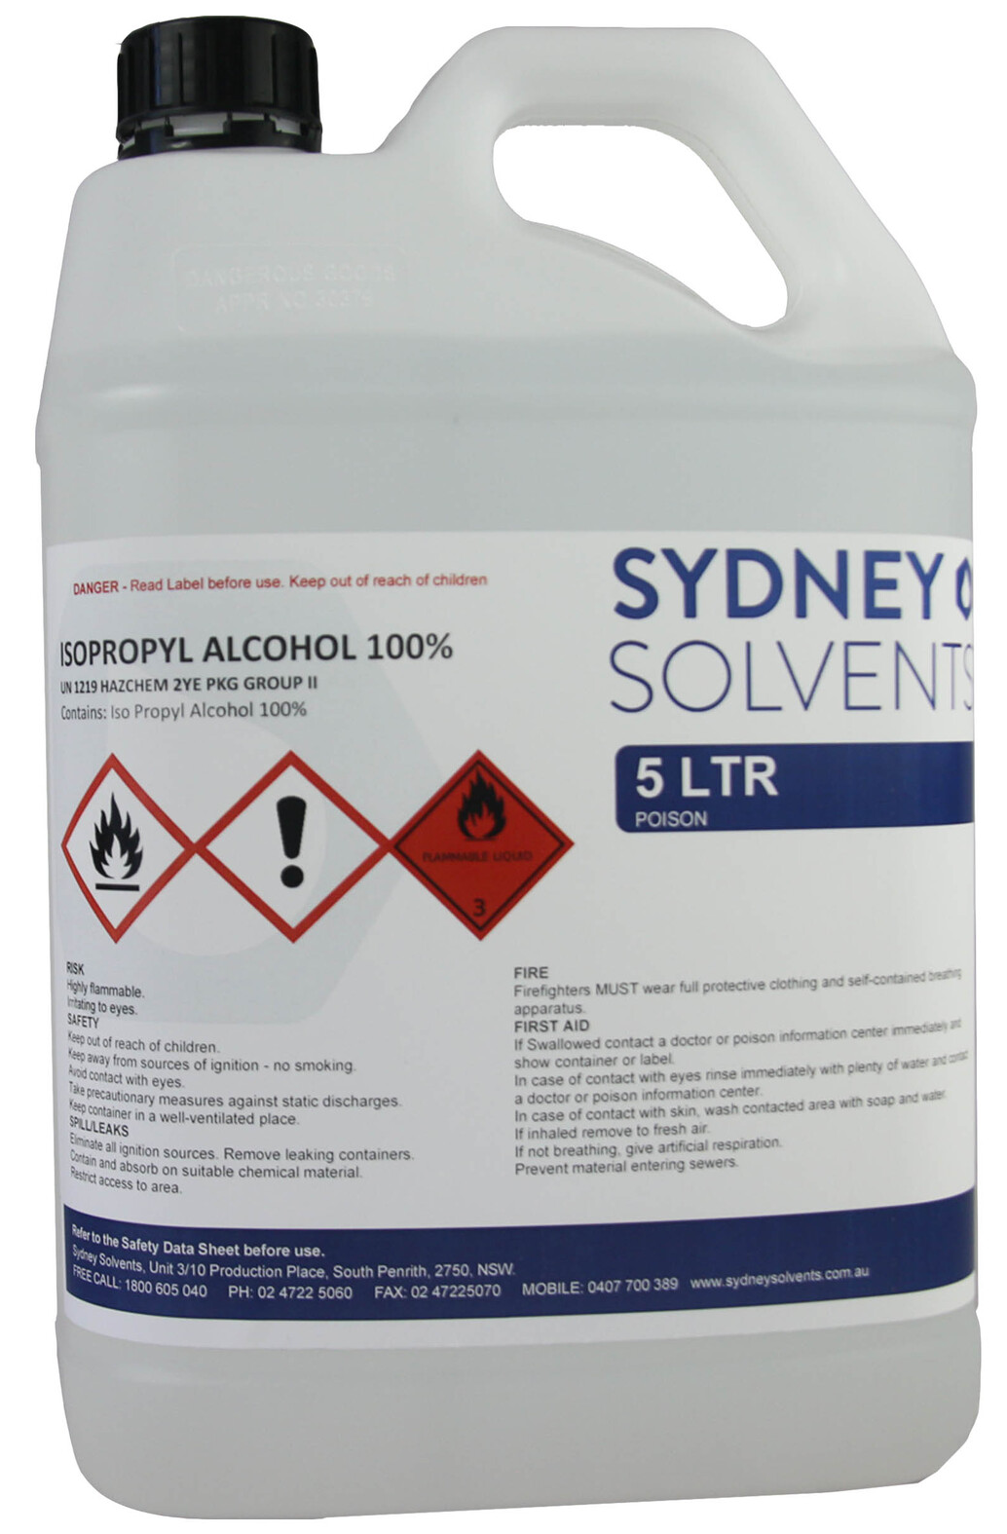
Bucky Paper Production
Timothy Norman
200 grams Isopropyl Alcohol
0.125 grams of powdered CNTs
Sonicated for a total of 3 hours and 15 minutes
Vacuum filtered twice
Vacuum aided drying overnight
Produced a sheet of a thickness of 0.03 mm

Slide 23
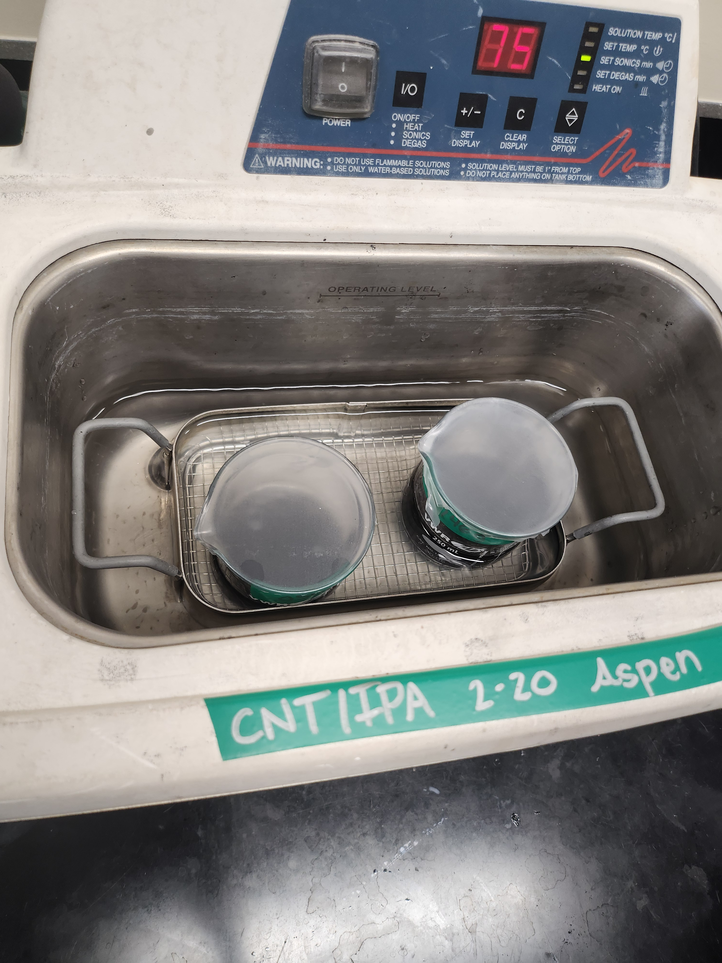
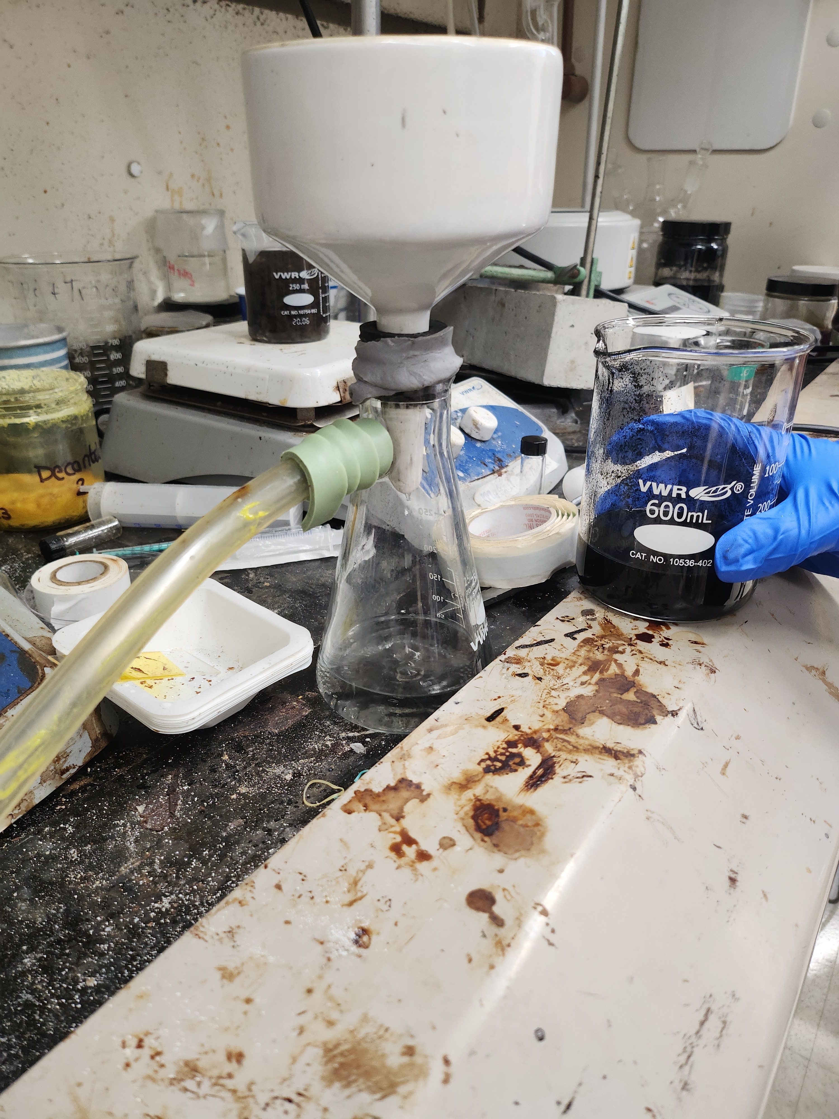
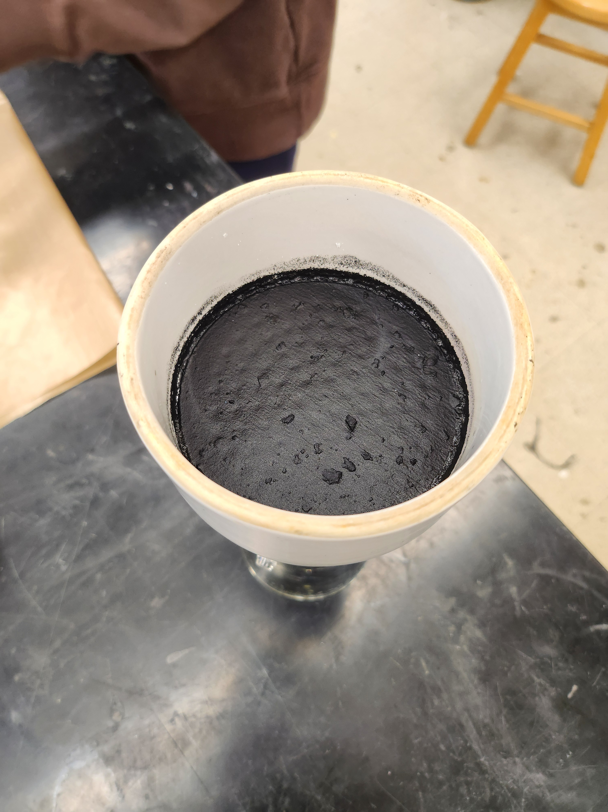
Bucky Paper Production
Timothy Norman
Sonication
Vacuum Filtration
Drying CNT film

Slide 24
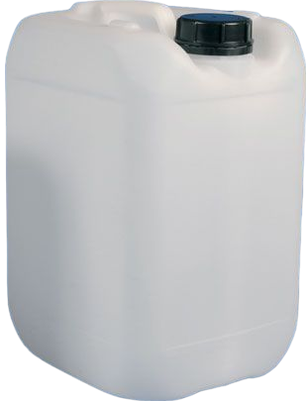
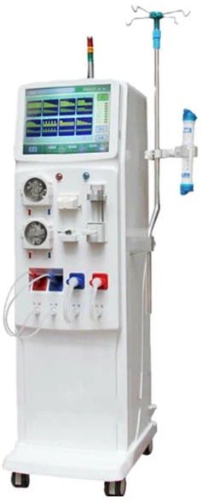
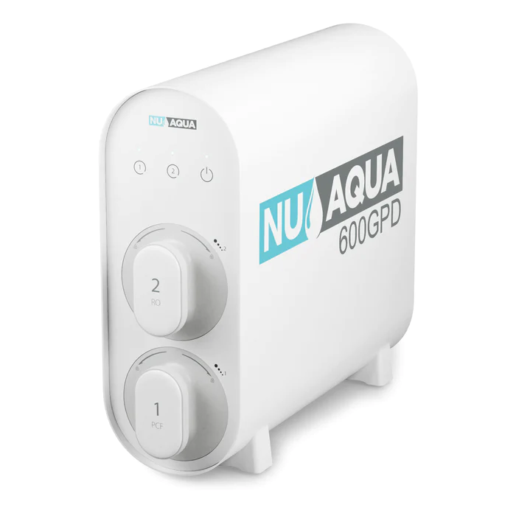
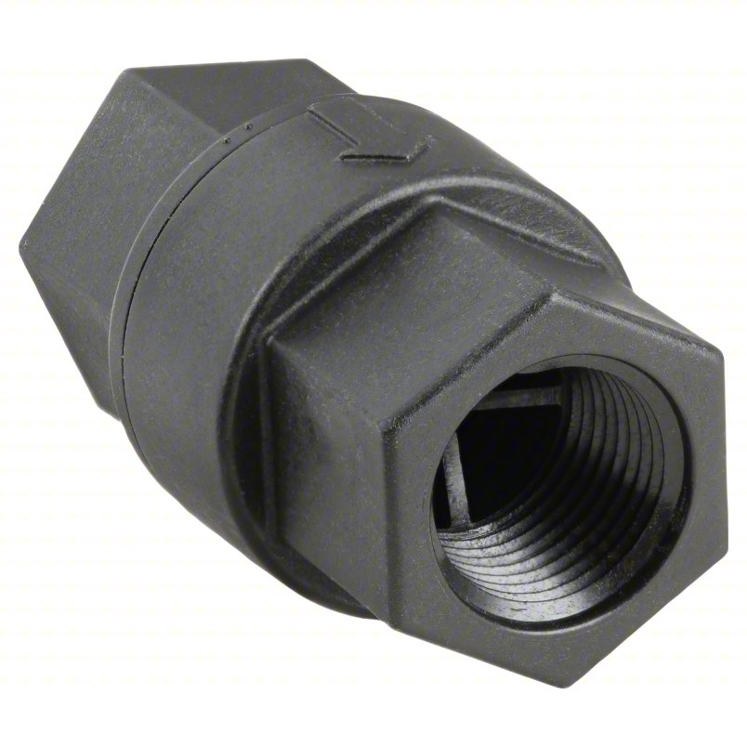
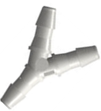


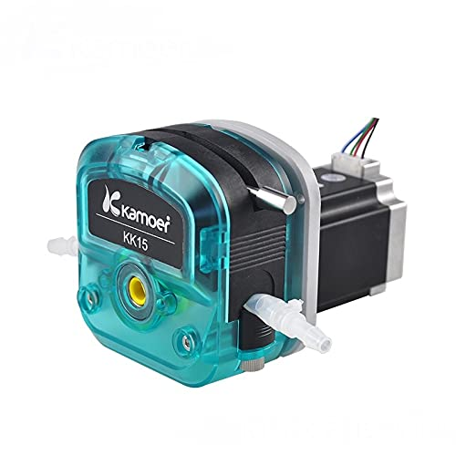
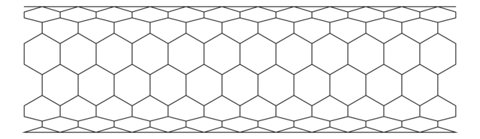
Water Quality Testing
Matthew Kennedy
Water Speed Testing
RO System
Filtered
Water Runoff
Water Quality Testing
Check Valves
CNT Filter
Primary Pump
Spent Dialysate Runoff

Slide 26
RO System
Matthew Kennedy
Claims to remove 99% of contaminants for drinking water standards
Filters last 12 – 24 months
Incoming water must be between 14.5 and 58 psi
Filters at 1590 mL per minute
Will have to adapt to two water inputs
Notes:
Should we go into the individual components?

Slide 27
Primary Pump
Matthew Kennedy
24V Stepper motor
Silicone tube,7.9mm ID × 11.1mm OD
Flow Rate of 1600ml/min
Ambient temperature 0-40℃
Relative humidity <80%
Reduction ratio 1:20
Notes:
Should we go into the individual components?

Slide 28
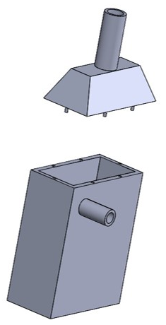
Initial vs Current Filter Prototype
Matthew Kennedy
Surrounding Shell
Ultrasonic Generator
CNT Membrane

Slide 29
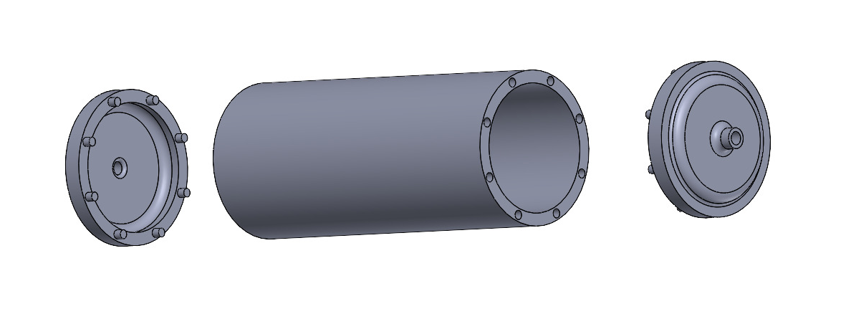
CAD Design
Matthew Kennedy
CNT Membrane
Connection to Y Connector
Spent Dialysate Inlet

Slide 30
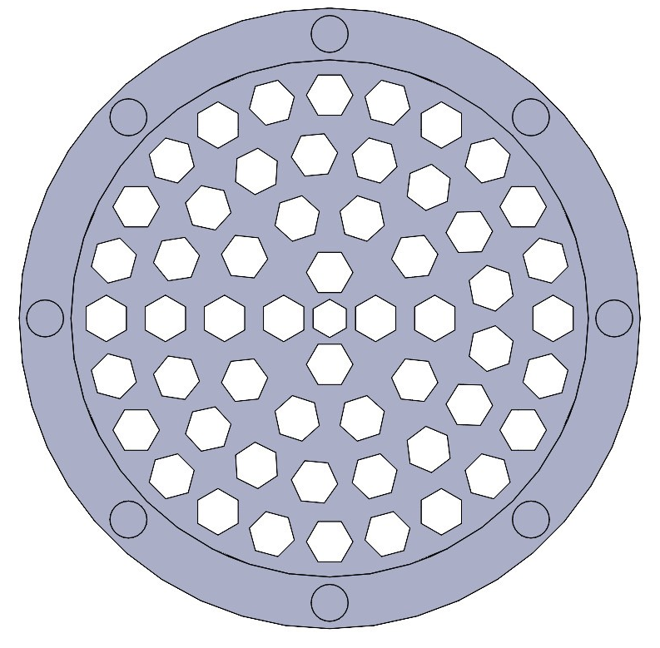
Updated CAD Design
Matthew Kennedy

Slide 31
Bill Of Materials
Matthew Kennedy
Total Dissolved Solid Pen
Spent
Urea
Carbon Nanotubes

Slide 32
Updated Bill Of Materials
Matthew Kennedy
Remaining

Slide 33


Barriers
Matthew Kennedy
Notes:
Ensuring the spent dialysate can’t leak around the CNT when placed into the housing.
FSU red flagging the Urea

Slide 34


Solutions
Matthew Kennedy
Notes:
Test to see whether the fluid is leaking around the CNT
If so, dive into how to press fit the CNT into the housing without causing any damage.
Filled out paperwork allowing the urea to be shipped to us.

Slide 35
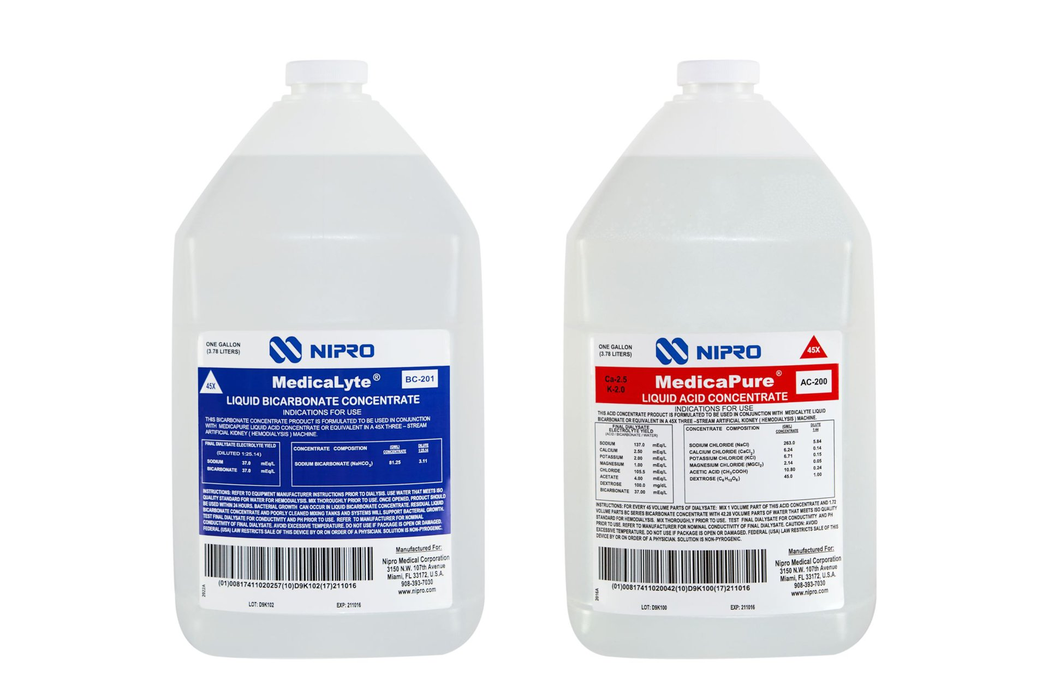
Testing Methods
Kencin Autry
Sodium: Na
Bicarbonate: HCO3
Potassium: K
Calcium: Ca
Magnesium: Mg
Chlorine: Cl
Sodium: Na
Notes:
*thoughts on needing to mention this in terms of simulating dialysate

Slide 36
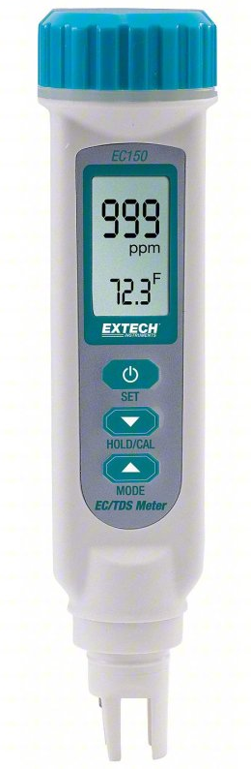
Testing Methods
Matthew Kennedy
TDS : 0 – 19.99 ppt
Conductivity
Water Temp
Filtered Water
pH
Notes:
https://www.grainger.com/product/EXTECH-Conductivity-Meter-38W993

Slide 37
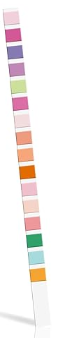
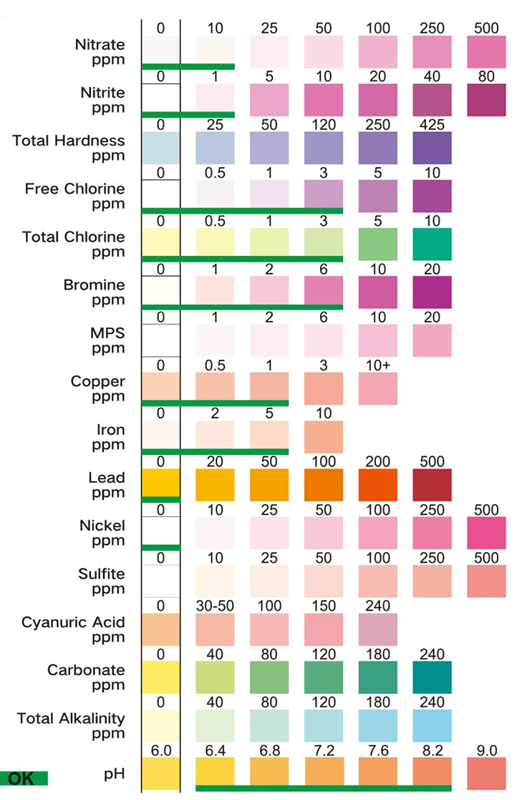
Testing Methods
Matthew Kennedy
Filtered Water
Notes:
Urea raises the pH and

Slide 38
Future Work
Matthew Kennedy
Finish Testing and Tuning Peristaltic Pump
Develop Second Round of CNTs
Concept
Selection
Connect Piping and Water System
Testing and Verification of Water Quality
38

Slide 39

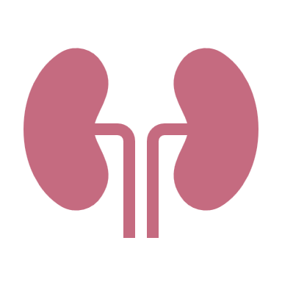





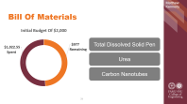


LinkedIn
Thank You
Kencin Autry
Matt Kennedy
Lily Thompson
Lapadre Proctor
Timothy Norman
Notes:
Add groups linked in info in QR code

Slide 40
Backup Slides

Slide 41
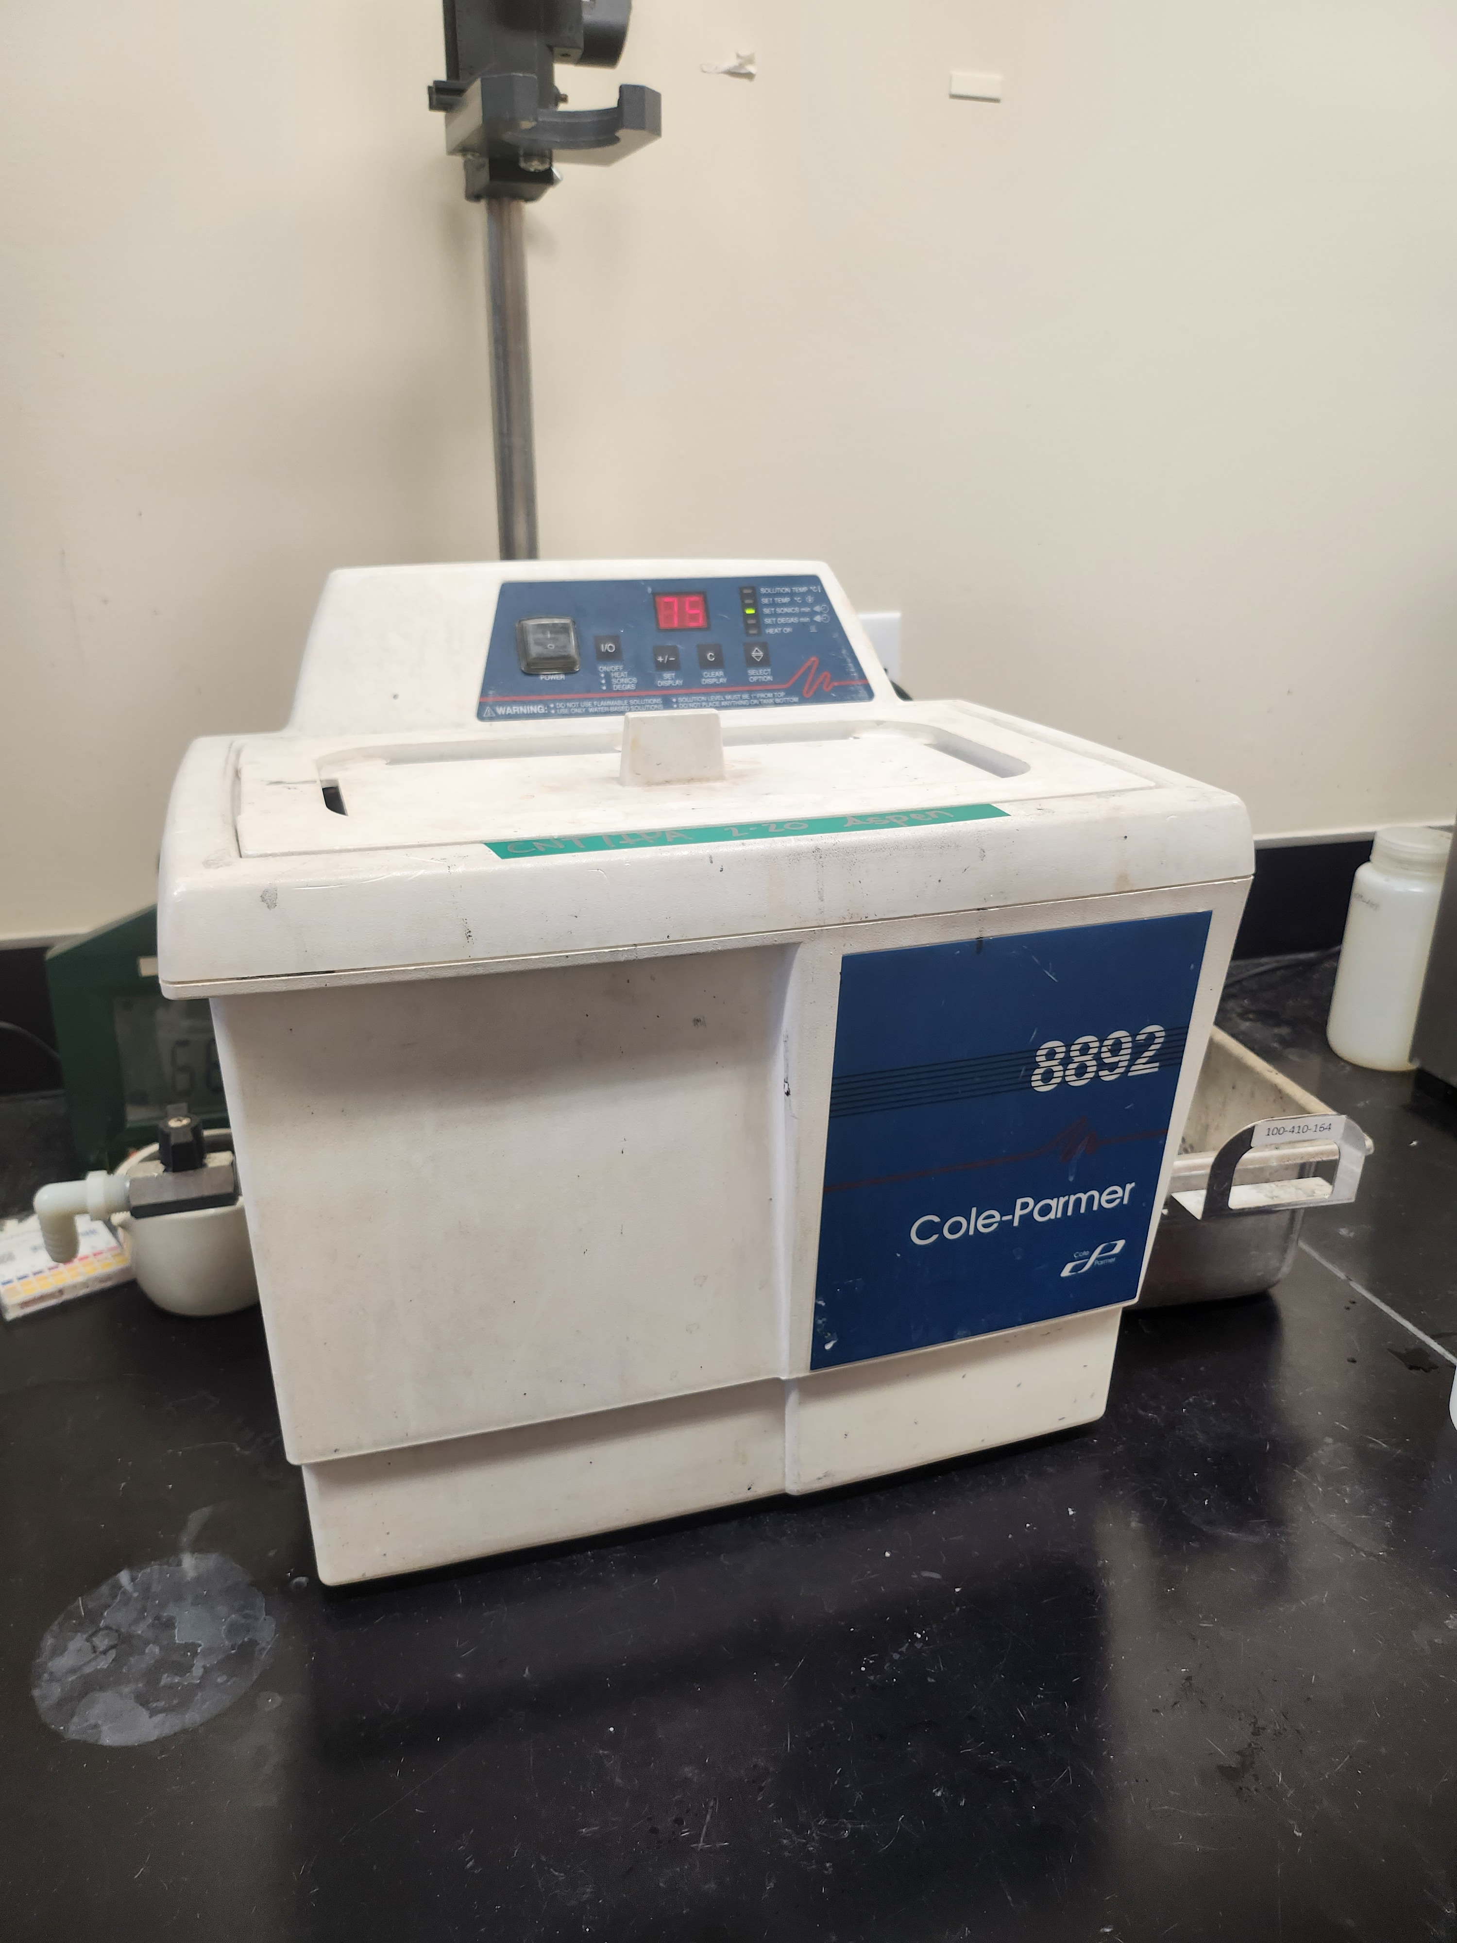
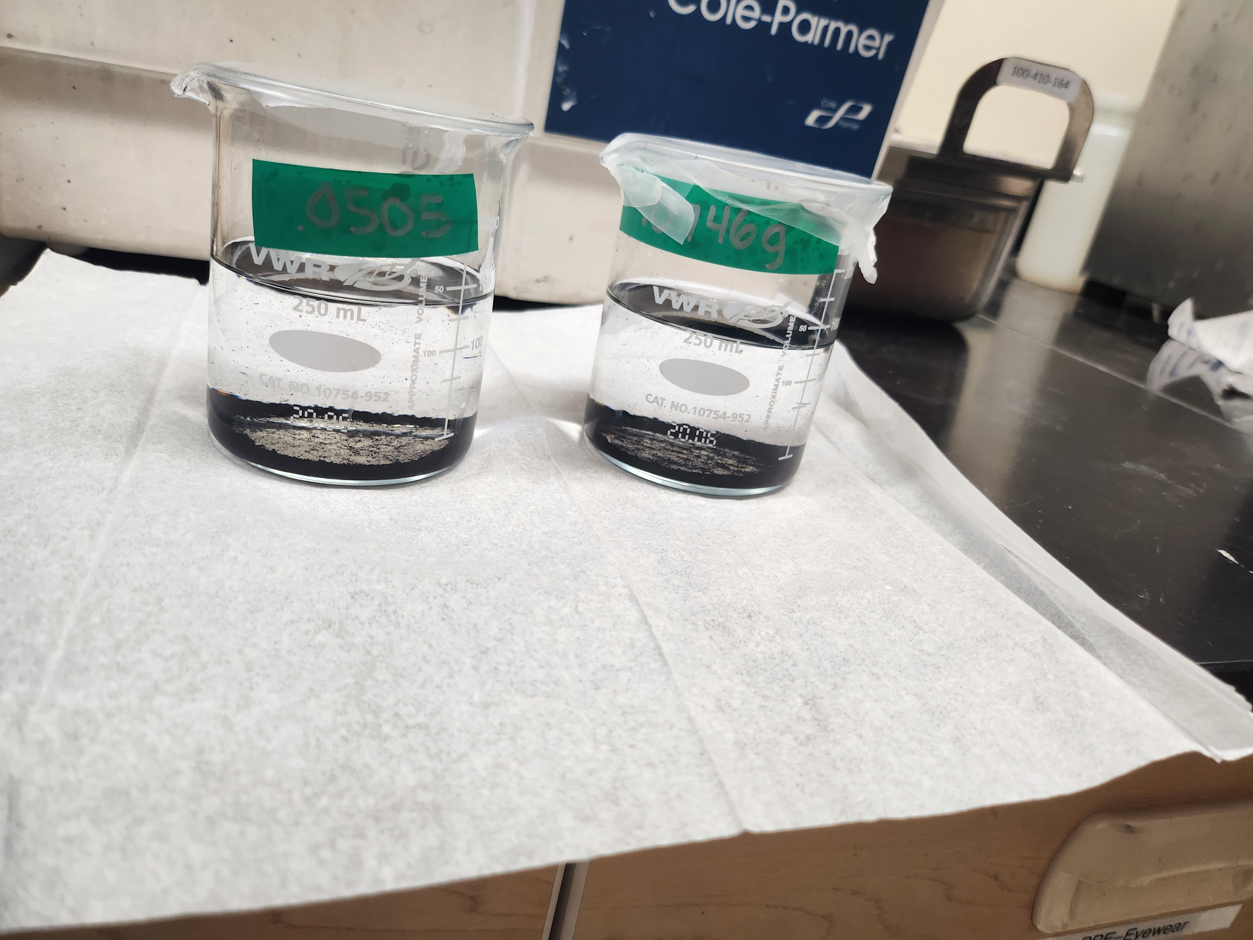

Slide 42
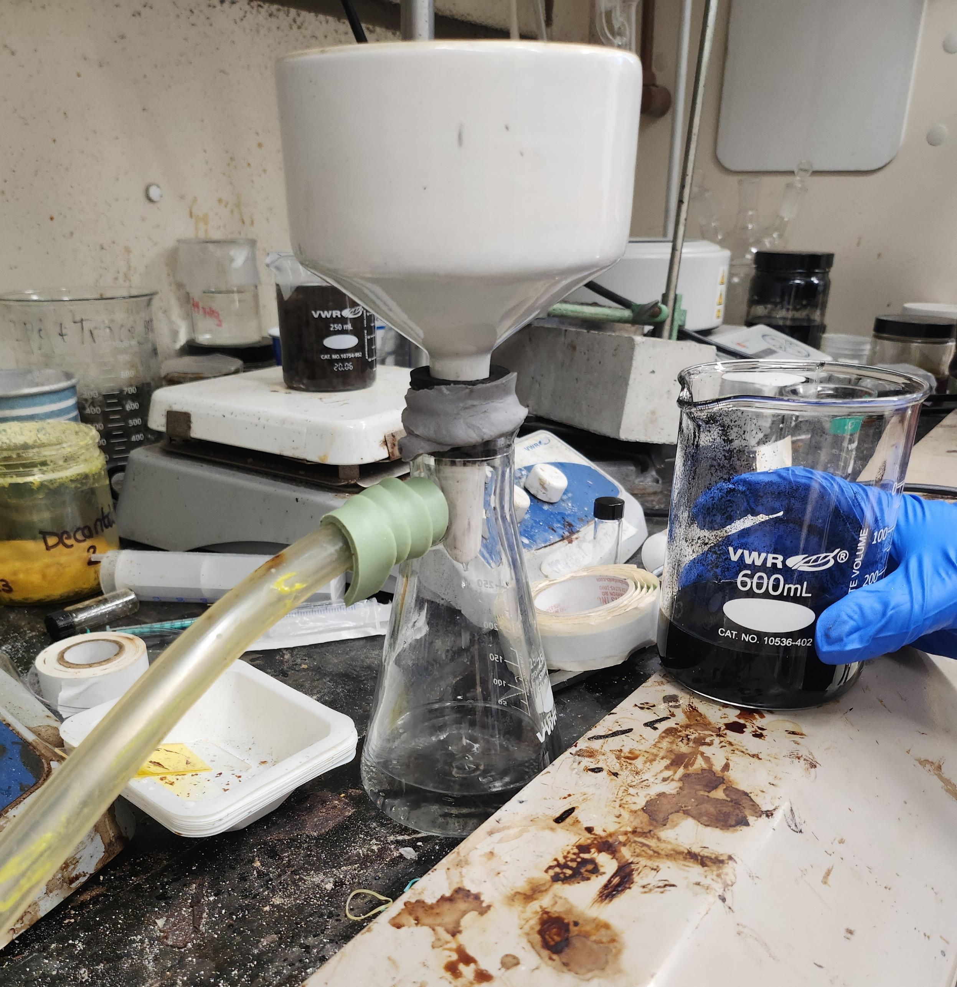
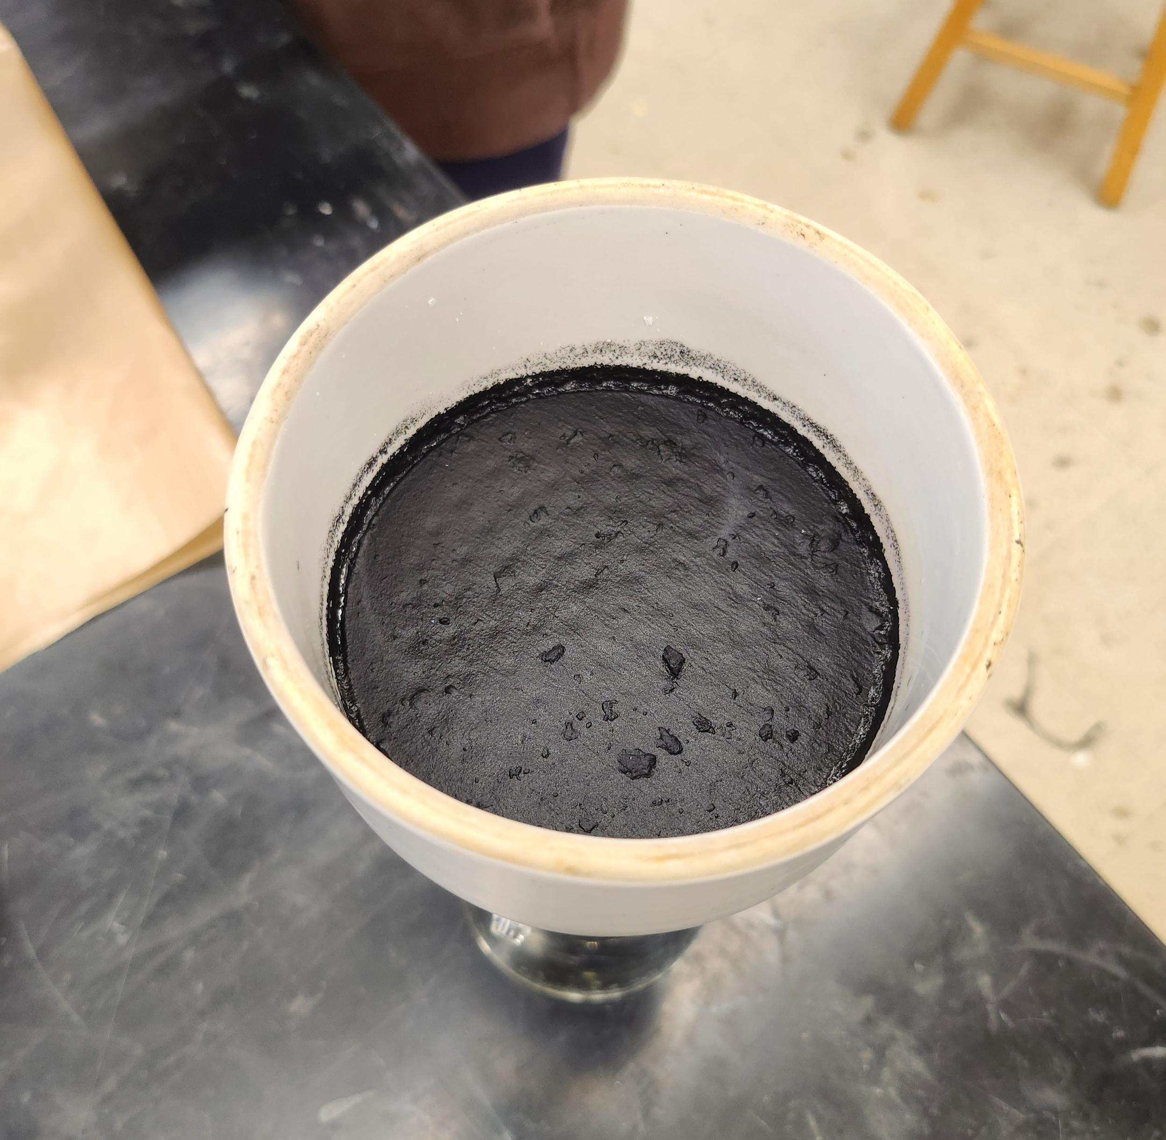

Slide 43
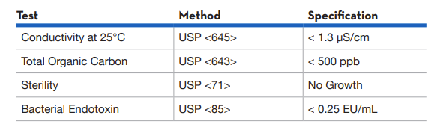
Ultra-Pure Standards Table

Slide 44
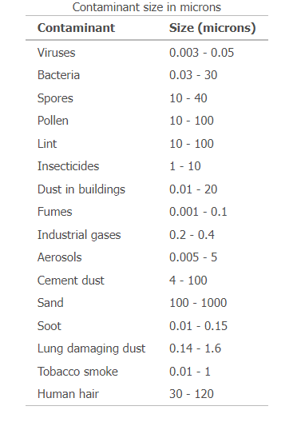
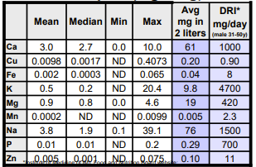
Contaminants Found in Tap Water

Slide 45
Standards for Ultra-Pure Water
Ultrapure water (UPW) is water that has been purified to high levels of specification:
  Extremely low total dissolved solids (TDS) level
  High electrical resistivity
  Free from chloride, sulfate, sodium, calcium, magnesium
  Minimal levels of organic contaminants, > 1 ppb

Slide 46
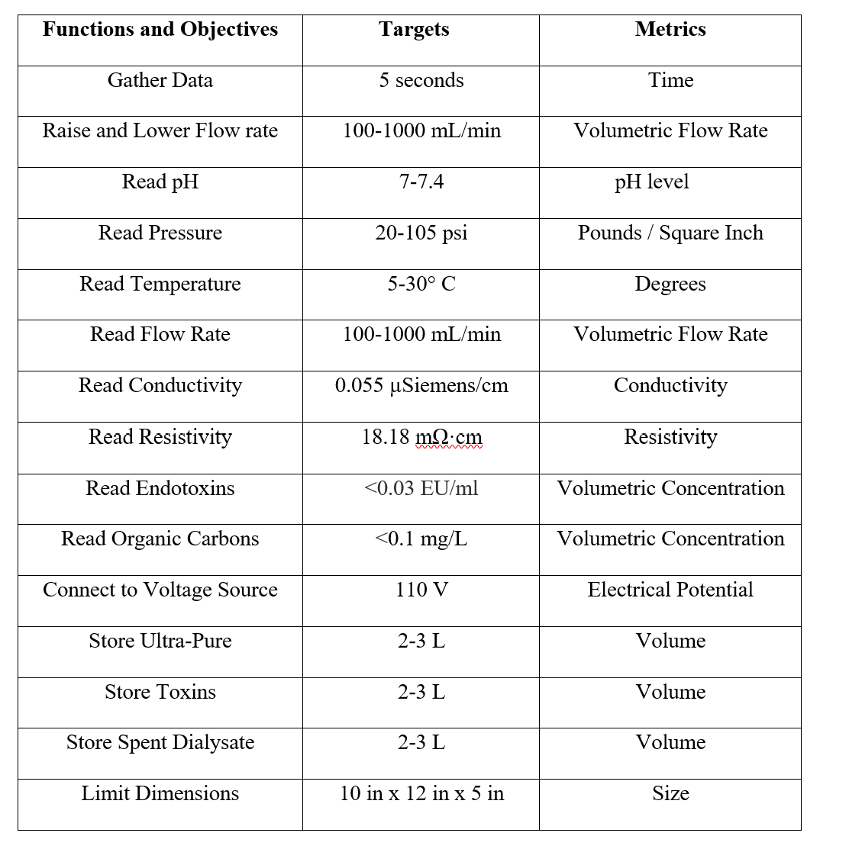
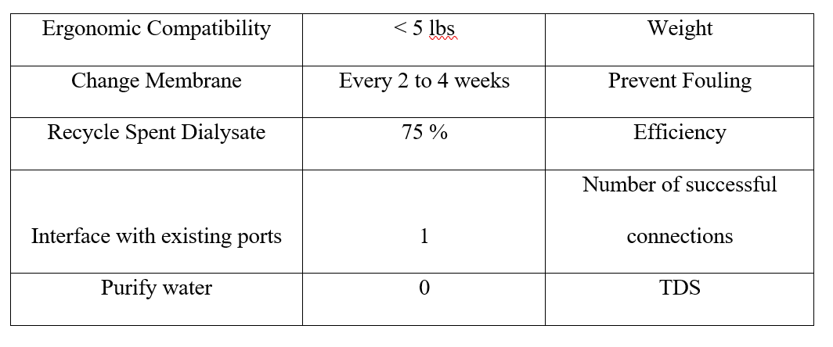
Targets and Metrics Table

Slide 47
Concept Selection
Matt Kennedy
Analytical Hierarchy Process
Concept | Alternative Value
Nano-filtration and Reverse Osmosis | 0.247
Nano-filtration | 0.382
Forward Osmosis | 0.382

Slide 48

Nasa CNT and Ultrasonic Patent

Slide 49

Functional Decomp Priority Rating

Slide 50

Functional Decomp Cross Reference

Slide 51





Calculations for Laminar Flow
$$ρ=1000 \frac{kg}{m^{3}} , v= ?, average diameter of a nanotube d=2.0 x {10}^{−9} ,$$
$$μ=0.0008891 \frac{N∗s}{m^{2}}$$
$Re$ = $\frac{ρvd}{μ}$
To find the velocity:
Given, by our customer, a flow rate of $1000 \frac{mL}{min}$
1000 ${mL}/{min}$ $→$ converted to $1.67 x {10}^{−5}{m^{3}}/s$
$1.67 x {10}^{−5}{m^{3}}/s$ $→$ converted to $5.32 x {10}^{3}\frac{m}{s}$
$$Re= \frac{(1000 \frac{kg}{m^{3}})(5.32 x {10}^{3}\frac{m}{s})(2.0 x {10}^{−9})}{(0.0008891 \frac{N∗s}{m^{2}})}$$
$Re≈12$, indicating a Laminar Flow

Slide 52

What a Dialyzer Looks Like

Slide 53


Slide 54


Slide 55
Hemodialysis and Peritoneal
Hemodialysis is ongoing dialysis (3 to 5 times a week) that cleans your blood, usually in a dialysis center. The hemodialysis access is in your arm.
Peritoneal dialysis is ongoing dialysis (daily) that collects waste from the blood by washing the empty space in the abdomen (peritoneal cavity). It can be done from home. The access for this is in your abdomen.

Slide 56
Reasons Why
The spent dialysate is a highly saline liquid consisting of urea, creatinine, uric acid, phosphate, etc.
A major challenge for the reuse of spent dialysate is removal of urea, the main nitrogenous waste product.
Due to its small molecular weight (60 Da) and electroneutral nature, it is difficult to be removed by sorbents.
Key Drawbacks:
System complexity
High energy cost
Membrane fouling and scaling

Slide 57
Current System Schematic
Kencin Autry
Ultra-Pure Runoff
Dialysis Machine
Water Supply
Filter
Dialysate Runoff
Notes:
*include specific parts we’ve ordered
Water supply will need to include the RO system
Filter will need to to be the CNT membrane
Pumps and piping being used

Slide 58


Timothy Norman
Primary Markets
Hospitals and Medical Care Facilities
At-home patients
58

Slide 59


Timothy Norman
Secondary Markets
Nursing and Retirement Care
Pharmaceuticals
City Water Treatment
Food Manufacturing
59

Slide 60






Slide 61
This is 10-point
This is 15–point Times
This is 20–point
This is 25–point
This is 30–point
This is 35–point
This is 40–point
This is 50–point
This is 60–point
This is 72–point
Notes:
Use at least 20-point font in Room A105, B134, and B136
Use at least 25-point font in Room B135

Slide 63
Notes:
Filter process design

Slide 65
Develop CNT Membrane and Housing
Connect Water and Piping System
Testing and Verification of Fluid Flow
Testing and Verification of Water Quality
Senior Design Day
Feb 20th
Feb 27th
Mar. 5th
Mar. 13th
Apr. 4th

Slide 66
Lily Thompson
Assumptions
Hemodialysis and peritoneal will be the main medical processes the system is used for
The system will only be used by one patient at a time
The incoming flow is laminar
66

Slide 67
Lily Thompson
Assumptions
Hemodialysis and peritoneal will be the main medical processes the system is used for
The system will only be used by one patient at a time
The incoming flow is laminar
67

Slide 68
College of Engineering Color Palette
1 2 3 4
Pantone: PMS 195 C
RGB: 120, 47, 64
Hex: #782F40
CMYK:19, 90, 50, 55
1 2 3 4
Pantone: Black C
RGB: 0, 0, 0
Hex: #000000
CMYK:0, 0, 0, 100
Garnet
Black
1 2 3 4
RGB: 238, 118, 36
Hex: #EE7624
CMYK:2, 66, 99, 0
1 2 3 4
Pantone: PMS 000C
RGB: 255, 255, 255
Hex: #FFFFFF
CMYK: 0, 0, 0, 0
Fang
Orange
White
Notes:
Avoid 75% Black in B135

Slide 69
Accent Color Palette
1 2 3 4
RGB: 0, 59, 111
Hex: #003B6F
CMYK:
1 2 3 4
RGB: 0, 59, 111
Hex: #003B6F
CMYK:
1 2 3 4
RGB: 251, 236, 93
Hex: #FBEC5D
CMYK:
1 2 3 4
RGB: 219, 215, 210
Hex: #DBD7D2
CMYK:
1 2 3 4
RGB: 251, 236, 93
Hex: #FBEC5D
CMYK:
1 2 3 4
RGB: 219, 215, 210
Hex: #DBD7D2
CMYK:
Tardis Blue
Tardis Blue
Corn
Timberwolf
Corn
Timberwolf
1 2 3 4
RGB: 206, 0, 88
Hex: #CE0058
CMYK: 0, 100, 43, 12
1 2 3 4
RGB: 206, 0, 88
Hex: #CE0058
CMYK: 0, 100, 43, 12
1 2 3 4
RGB: 104, 40, 96
Hex: #682860
CMYK:
1 2 3 4
RGB: 220, 220, 220
Hex: #DCDCDC
CMYK:
Rubine Red
Rubine Red
Imperial
Gainsboro
1 2 3 4
RGB: 72, 146, 155
Hex: #48929b
CMYK:
1 2 3 4
RGB: 64, 224, 208
Hex: #40E0D0
CMYK:
1 2 3 4
RGB: 255, 139, 0
Hex: #FF8B00
CMYK:
Asagi-iro
Turquoise
American Orange
Notes:
Remove American orange add hyperlink grey
Make corn the last for b135
All work in 134 imperial move later
Tardis doesn’t work in b136

Slide 70
F7AB19
D67F15
EE7624
D64615
F73119
Analogous
https://color.adobe.com/create/color-wheel
6E3610
F0A16C
EE7624
6E4931
BASB1C
Monochromatic
A14508
4BED3B
EE7624
250CED
2010A1
Triad
A1470C
FF8C40
EE7624
0098A1
24E2ED
Complementary
28A164
2FED8D
EE7624
0848A1
1871ED
Split Complementary
EDAC2F
3BED93
EE7624
0C6AED
ED2F18
Double Split Complementary
ED660C
C7ED3B
EE7624
0CE1ED
A418ED
Square
BA7E09
87724A
EE7624
60EFCF
09BA61
Compound
AD551A
6E3610
EE7624
FA7625
D46820
Shades
Notes:
These are the variants that work well with Fang Orange. The bolded items show well on the projectors.

Slide 71
85412D
8F3831
782f40
8F3176
792D85
Analogous
https://color.adobe.com/create/color-wheel
C44D69
8E626D
782F40
C48796
451B25
Monochromatic
C43959
78743B
782F40
236178
43A2C4
Triad
C43959
C46078
782F40
25C43D
2F783A
Complementary
93C460
577835
782F40
39C49D
297861
Split Complementary
784435
5A783B
782F40
237860
6E2978
Double Split Complementary
782337
78683b
782F40
237830
293978
Square
AB4D32
DEBAAF
782F40
5D8555
70AB32
Compound
38161E
C44D69
782F40
853447
5E2532
Shades

Slide 72
A105
A105
B135 Stage Left
B135 Stage Right
B136
B134, A105
B135

Slide 78























Logos and icons

Slide 79
Citations
blood dialysis by Andy Horvath from <a href="https://thenounproject.com/browse/icons/term/blood-dialysis/" target="_blank" title="blood dialysis Icons">Noun Project</a> (CC BY 3.0)
Kidney by Febrian Hidayat from <a href="https://thenounproject.com/browse/icons/term/kidney/" target="_blank" title="Kidney Icons">Noun Project</a> (CC BY 3.0)
Dialysis Machine by bsd studio from <a href="https://thenounproject.com/browse/icons/term/dialysis-machine/" target="_blank" title="Dialysis Machine Icons">Noun Project</a> (CC BY 3.0)
Dialysis Machine by Gan Khoon Lay from <a href="https://thenounproject.com/browse/icons/term/dialysis-machine/" target="_blank" title="Dialysis Machine Icons">Noun Project</a> (CC BY 3.0)
filter by Smalllike from <a href="https://thenounproject.com/browse/icons/term/filter/" target="_blank" title="filter Icons">Noun Project</a> (CC BY 3.0)
filter by Kiran Shastry from <a href="https://thenounproject.com/browse/icons/term/filter/" target="_blank" title="filter Icons">Noun Project</a> (CC BY 3.0)
filter by Kiran Shastry from <a href="https://thenounproject.com/browse/icons/term/filter/" target="_blank" title="filter Icons">Noun Project</a> (CC BY 3.0)
Waste by lastspark from <a href="https://thenounproject.com/browse/icons/term/waste/" target="_blank" title="Waste Icons">Noun Project</a> (CC BY 3.0)
Waste by lastspark from <a href="https://thenounproject.com/browse/icons/term/waste/" target="_blank" title="Waste Icons">Noun Project</a> (CC BY 3.0)
Adapter by mynamepong from <a href="https://thenounproject.com/browse/icons/term/adapter/" target="_blank" title="Adapter Icons">Noun Project</a> (CC BY 3.0)
Outlet by Darrin Loeliger from <a href="https://thenounproject.com/browse/icons/term/outlet/" target="_blank" title="Outlet Icons">Noun Project</a> (CC BY 3.0)
Water Filter by I Putu Dicky Adi Pranatha from <a href="https://thenounproject.com/browse/icons/term/water-filter/" target="_blank" title="Water Filter Icons">Noun Project</a> (CC BY 3.0)
Water Filter by Phonlaphat Thongsriphong from <a href="https://thenounproject.com/browse/icons/term/water-filter/" target="_blank" title="Water Filter Icons">Noun Project</a> (CC BY 3.0)
water treatment by Soremba from <a href="https://thenounproject.com/browse/icons/term/water-treatment/" target="_blank" title="water treatment Icons">Noun Project</a> (CC BY 3.0)
water treatment by Soremba from <a href="https://thenounproject.com/browse/icons/term/water-treatment/" target="_blank" title="water treatment Icons">Noun Project</a> (CC BY 3.0)
Faucet by Uswa KDT from <a href="https://thenounproject.com/browse/icons/term/faucet/" target="_blank" title="Faucet Icons">Noun Project</a> (CC BY 3.0)
IV Bag by Ralf Schmitzer from <a href="https://thenounproject.com/browse/icons/term/iv-bag/" target="_blank" title="IV Bag Icons">Noun Project</a> (CC BY 3.0)
Reservoir by Adrien Coquet from <a href="https://thenounproject.com/browse/icons/term/reservoir/" target="_blank" title="Reservoir Icons">Noun Project</a> (CC BY 3.0)

Slide 80
Citations
R. Nystrand Microbiology of water and fluids for hemodialysis J. Chin. Med. Assoc., 71 (5) (2008), pp. 223-229
J.W.M. Agar Conserving water in and applying solar power to haemodialysis: ’Green Dialysis’ through wiser resource utilization Nephrology, 15 (4) (2010), pp. 448-453
https://www.umms.org/ummc/health-services/kidney/dialysis/types#:~:text=Hemodialysis%20is%20ongoing%20dialysis%20(3,can%20be%20done%20from%20home.

